Slide 1


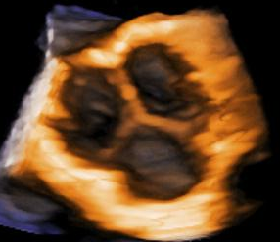
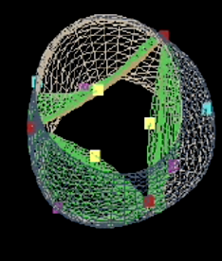
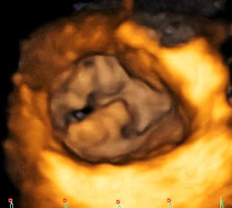
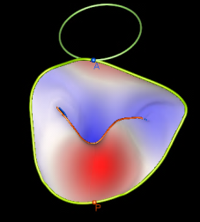
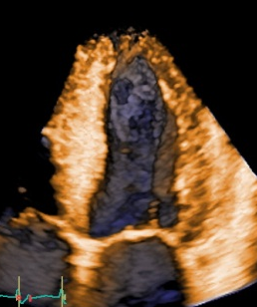
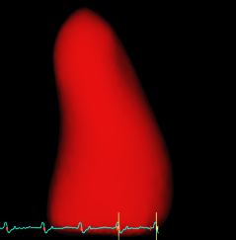
Department of Cardiac, Thoracic and Vascular Sciences
University of Padua
Head of Department: Prof. Sabino Iliceto
3D ECHO INTENSIVE COURSE
Course Directors: Luigi P. Badano, Denisa Muraru
The advent of three-dimensional echocardiography (3D echo) has significantly improved the impact of non-invasive imaging on our understanding and management of cardiac diseases in clinical practice. Transthoracic 3D echo enables an easier, more accurate and reproducible interpretation of the complex cardiac anatomy, overcoming the intrinsic limitations of conventional echocardiography.
The availability of unprecedented views of cardiac structures from any perspective in the beating heart provides valuable clinical information and new levels of confidence in diagnosing heart disease. One major advantage of the third dimension is the improvement in the accuracy and reproducibility of chamber volume measurement by eliminating geometric assumptions and errors caused by foreshortened views. Another benefit of 3D echo is the realistic en face views of heart valves, enabling a better appreciation of the severity and mechanisms of valve diseases in a unique, noninvasive manner.
However, 3D echo is a technically demanding technique and, for its effective use, echocardiographers need specific education and training. They have to learn how to acquire volumetric data sets without artifacts, and navigate within the data set to obtain the desired view. New tools like cropping, slicing and thresholding are available to manipulate the data sets in order to visualize the cardiac structure of interest. Finally, various ways to display the information are available and can be used to address different clinical issues.
To help echocardiographer who wish to implement 3D echo in the routine of their echo-lab, a 4-day intensive theoretical and practical course with hands-on sessions in the morning and theoretical lessons in the afternoon has been set up.
Course Language: English (no translation will be available)
Venue: Department of Cardiac, Thoracic and Vascular Sciences, University of Padua Medical School, Via Giustiniani 2, 35128 Padua, Italy
Learning Objectives:
Those who will attend the theoretical sessions will receive a comprehensive up-to-date about state-of-the-art 3D transthoracic and transesophageal echocardiography.
Those who will attend both theoretical and practical sessions will also learn how to acquire 3D echo data sets, display them and perform quantitative analyses at workstation. No practical 3D transesophageal echo acquisition will be allowed to attendees for safety and legal reasons.
Important! The practical sessions will be performed using Vivid E9 and iE 33 echo scanners and EchoPac BT 12 and QLab 9.0 workstations.
Teaching Material and Tools:
a collection of review papers written by the course Directors covering most of the topics will be sent electronically in advance to all the attendees
those atteding the practical sessions will also be allowed to access a large data base of various clinical cases to practice during free time
3 hour/morning of practical course (acquisition + post processing on EchoPac workstations) with a dedicated tutor.
Suggested Readings:
Badano LP, Lang RM, Zamorano JL “Textbook of Real-Time Three-Dimensional Echocardiography” Springer-Verlag London Ltd, London, 2011
Badano LP, Galderisi M, Muraru D, Mondillo S. “Ecocardiografia Multi-planare e Tridimensionale Real-time”, MB&Care, Livorno; 2011 (book in Italian)
Shernan S, Lang R, Mor-Avi V, Shirali G. Comprehensive atlas of 3D echocardiography, Lippincott Williams & Wilkins, Philadelphia 2012
Shiota T. 3D echocardiography, 2nd edition, Taylor & Francis group, Boca Raton, 2013
Theoretical Sessions at 2:00 PM to 5:00 PM, from Monday to Thursday

Slide 2
Department of Cardiac, Thoracic and Vascular Sciences
University of Padua
Head of Department: Prof. Sabino Iliceto
3D ECHO INTENSIVE COURSE
May 23- 27, 2016
Course Directors: Luigi P. Badano, Denisa Muraru
Monday - Cardiology Classroom – 2.00pm- 5.30pm
1. General concepts about 3D vs 2D
Why do we need 3D?
3D probes (TTE and TOE)
Physics of 3D echocardiography
The third dimension
2. How to acquire and display 3D data sets
Acquisition modes
Rendering techniques
Cropping
Slicing
Thresholding
Artifacts and how to avoid them
Acquisition protocols
3D echo anatomy
3. How to implement 4D echo in the routine of the echo lab?
Tuesday -09.00am to 12.00pm in Echo Lab-
Practice – Hands on session
Cardiology Classroom – 2.00pm- 5.30pm- Theory
1. Left ventricle
Acquisition and display techniques
Volumes
Mass
Shape
4D strain
Regional and global function (ischemic heart disease, cardiomyopathies)
2. Right ventricle
Acquisition and display techniques
Regional and global function
3. Left and right atrium
Acquisition and display
Echo anatomy: left atrial appendage, pulmonary veins
Global geometry and phasic function
Wednesday - 09.00am to12.00pm in Echo Lab-
Practice – Hands on Session
Cardiology Classroom – 2.00pm- 5.30pm- Theory
1. Mitral valve
Acquisition and display techniques
Quantification
Mitral valve diseases
Mitral annulus quantification in normal and pathologies
2. Aortic valve
Acquisition and display techniques
Aortic valve diseases
3. Tricuspid valve
Acquisition and display techniques
Tricuspid valve diseases
Thursday -09.00am to 12.00pm in Echo Lab-
Practice – Hands on session
Cardiology Classroom – 2.00pm- 5.30pm- Theory
1. Congenital heart diseases
Atrial septal defects
Patent foramen ovale
Ventricular septal defects
Uni-, bi- and quadricuspid aortic valve
Mitral cleft
Parachute mitral valve
Cor triatriatum
Univentricular heart
Ebstein disease
2. Masses
Tumors
Thrombi
3. Pharmacological stress echo
4. Third-generation 3D transoesophageal echo
Friday -09.00am to 12.00pm in Echo Lab-
Practice – Hands on session

